Slide 1

Team 07

Slide 2

NGO challenge
Answering phone calls
Not enough knowledge/expertise for difficult questions
Notes:
The charity we are working with is the Brain Tumour Charity.

Slide 3

Goals
Quick access to information
Simple user interface
Improve efficiency
Scalable
Notes:
Brain Tumour Society main priority is to enable any member to pick up the phone
Have quick accessible information to the phone calls
Simple accessible user interface to contacts and information
Improve efficiencies within the company by encouraging knowledge transfer
Scalable to provide access to a organization with potentially many employees

Slide 4
Proposed solution
A KnowledgeBase based on a Web Application

Slide 5

System Architecture
SQL Queries

Slide 6
Problems encountered
Implementation of ElasticSearch

Slide 7
Demonstration
Strong foundations for a knowledge base to grow and expand

Slide 8
Future implementation
ElasticSearch

Slide 9
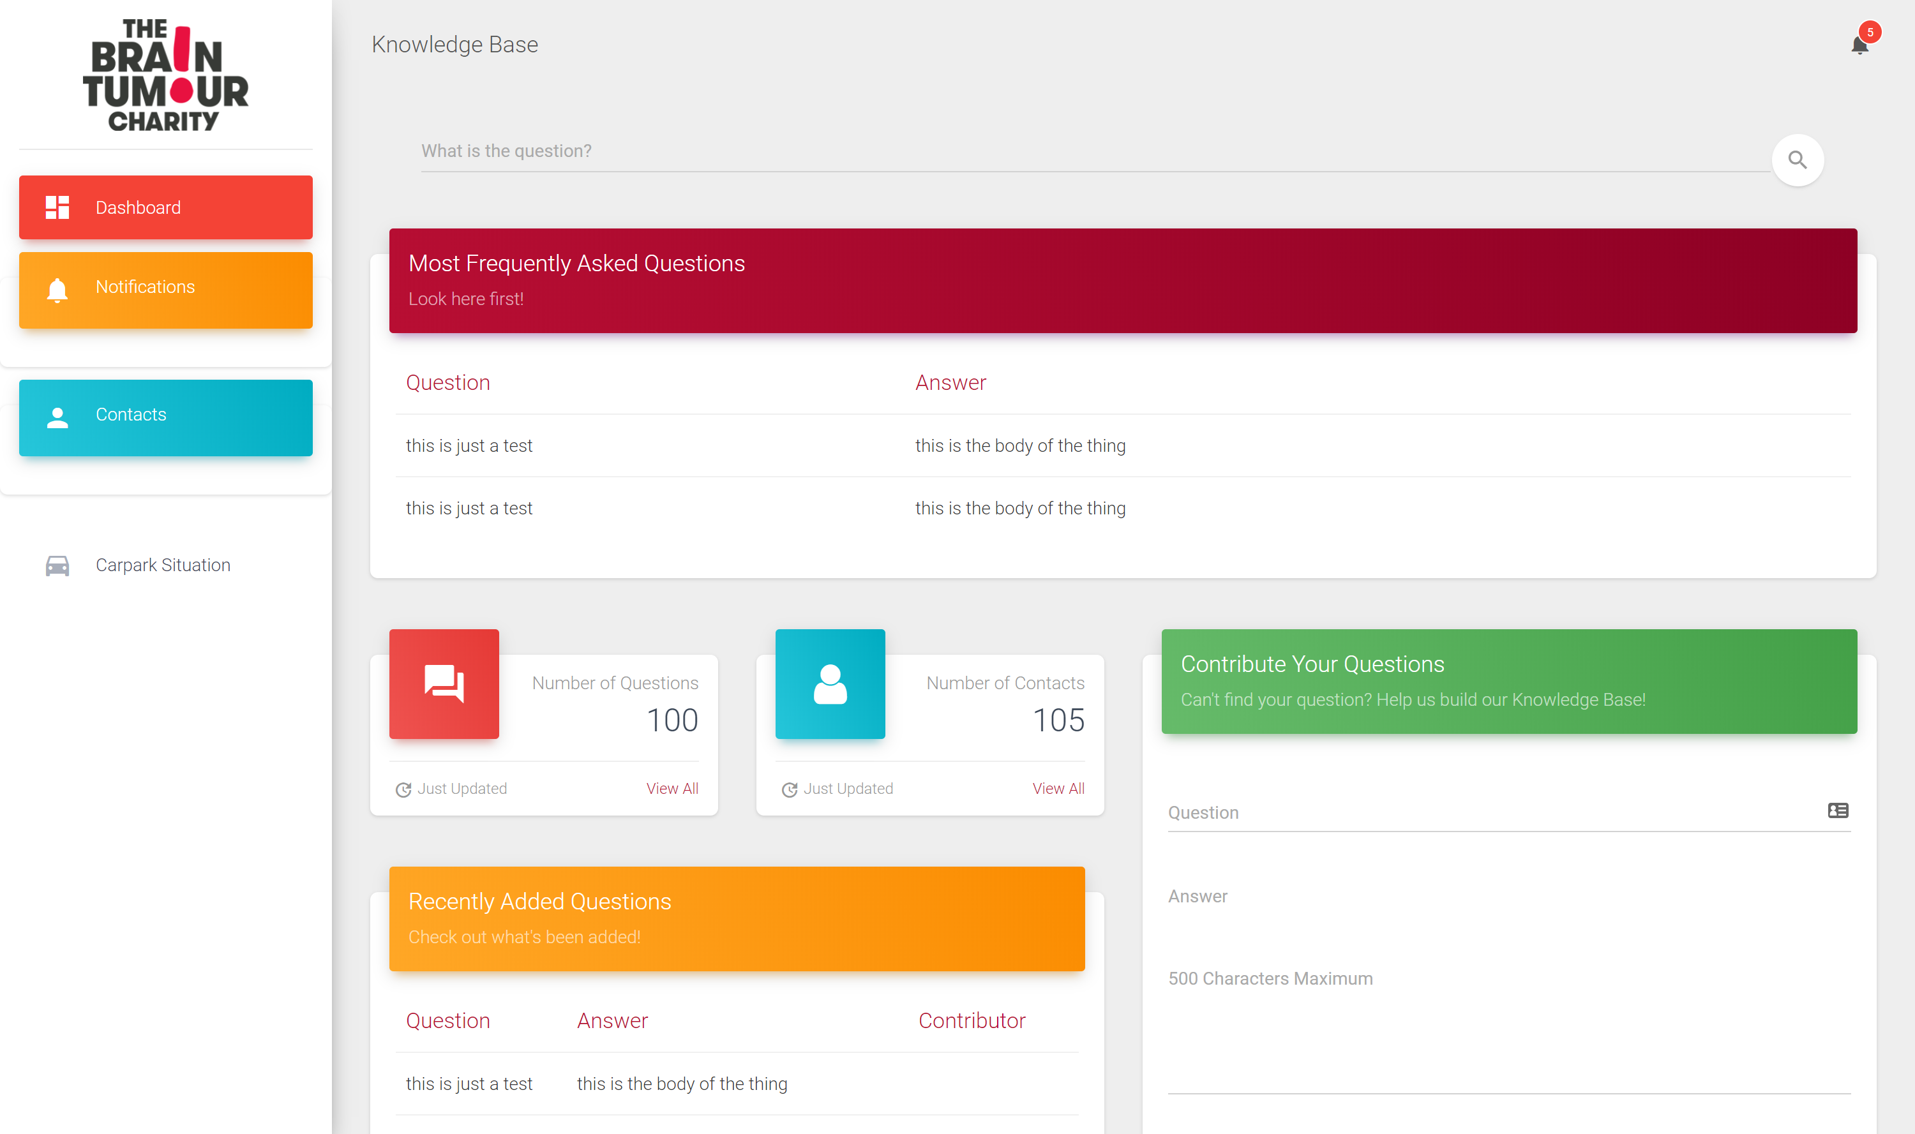

Slide 10
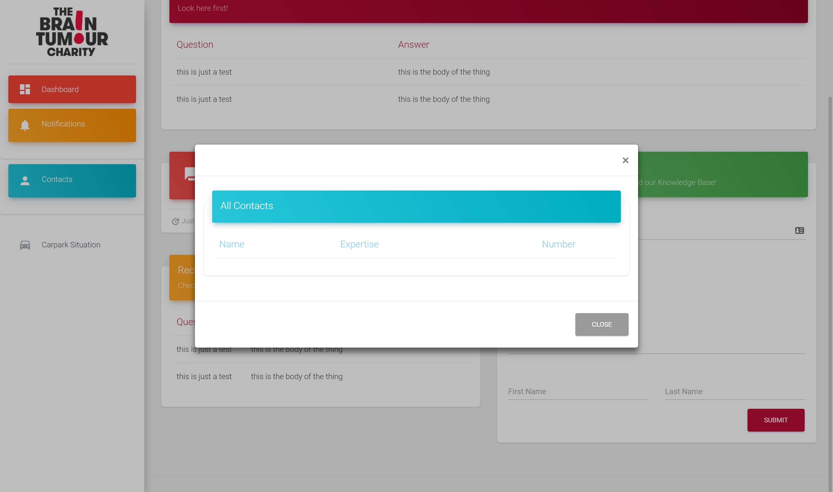
Notes:
Contacts window

Slide 11
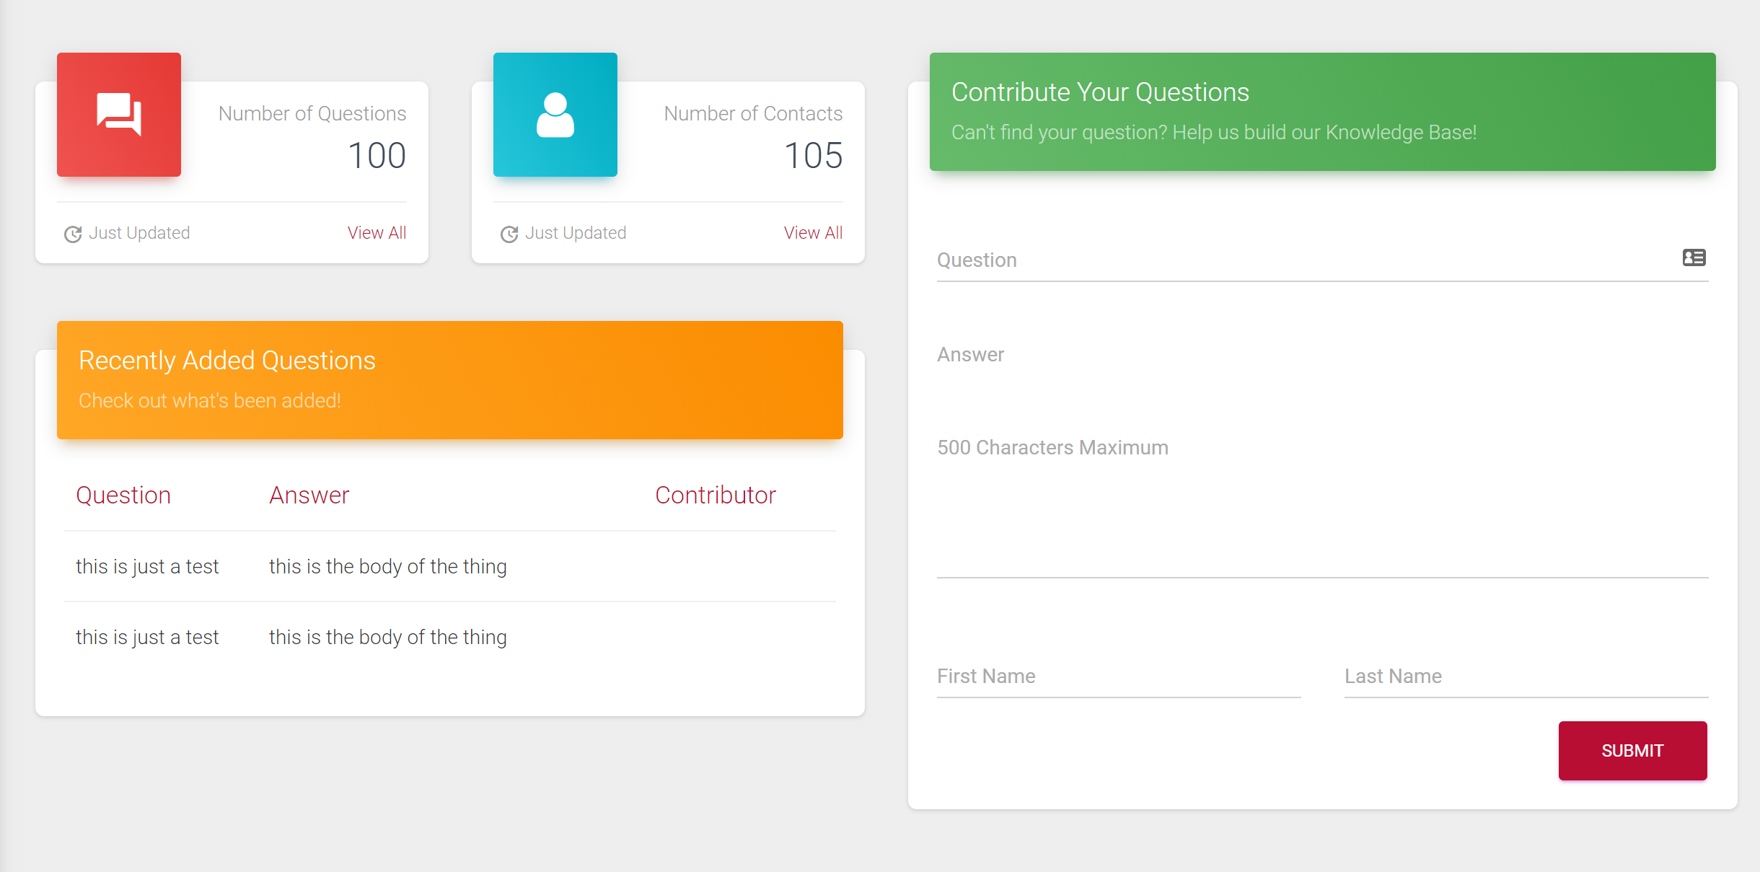
Notes:
Employees will be able to contribute to the knowledge base

Slide 12
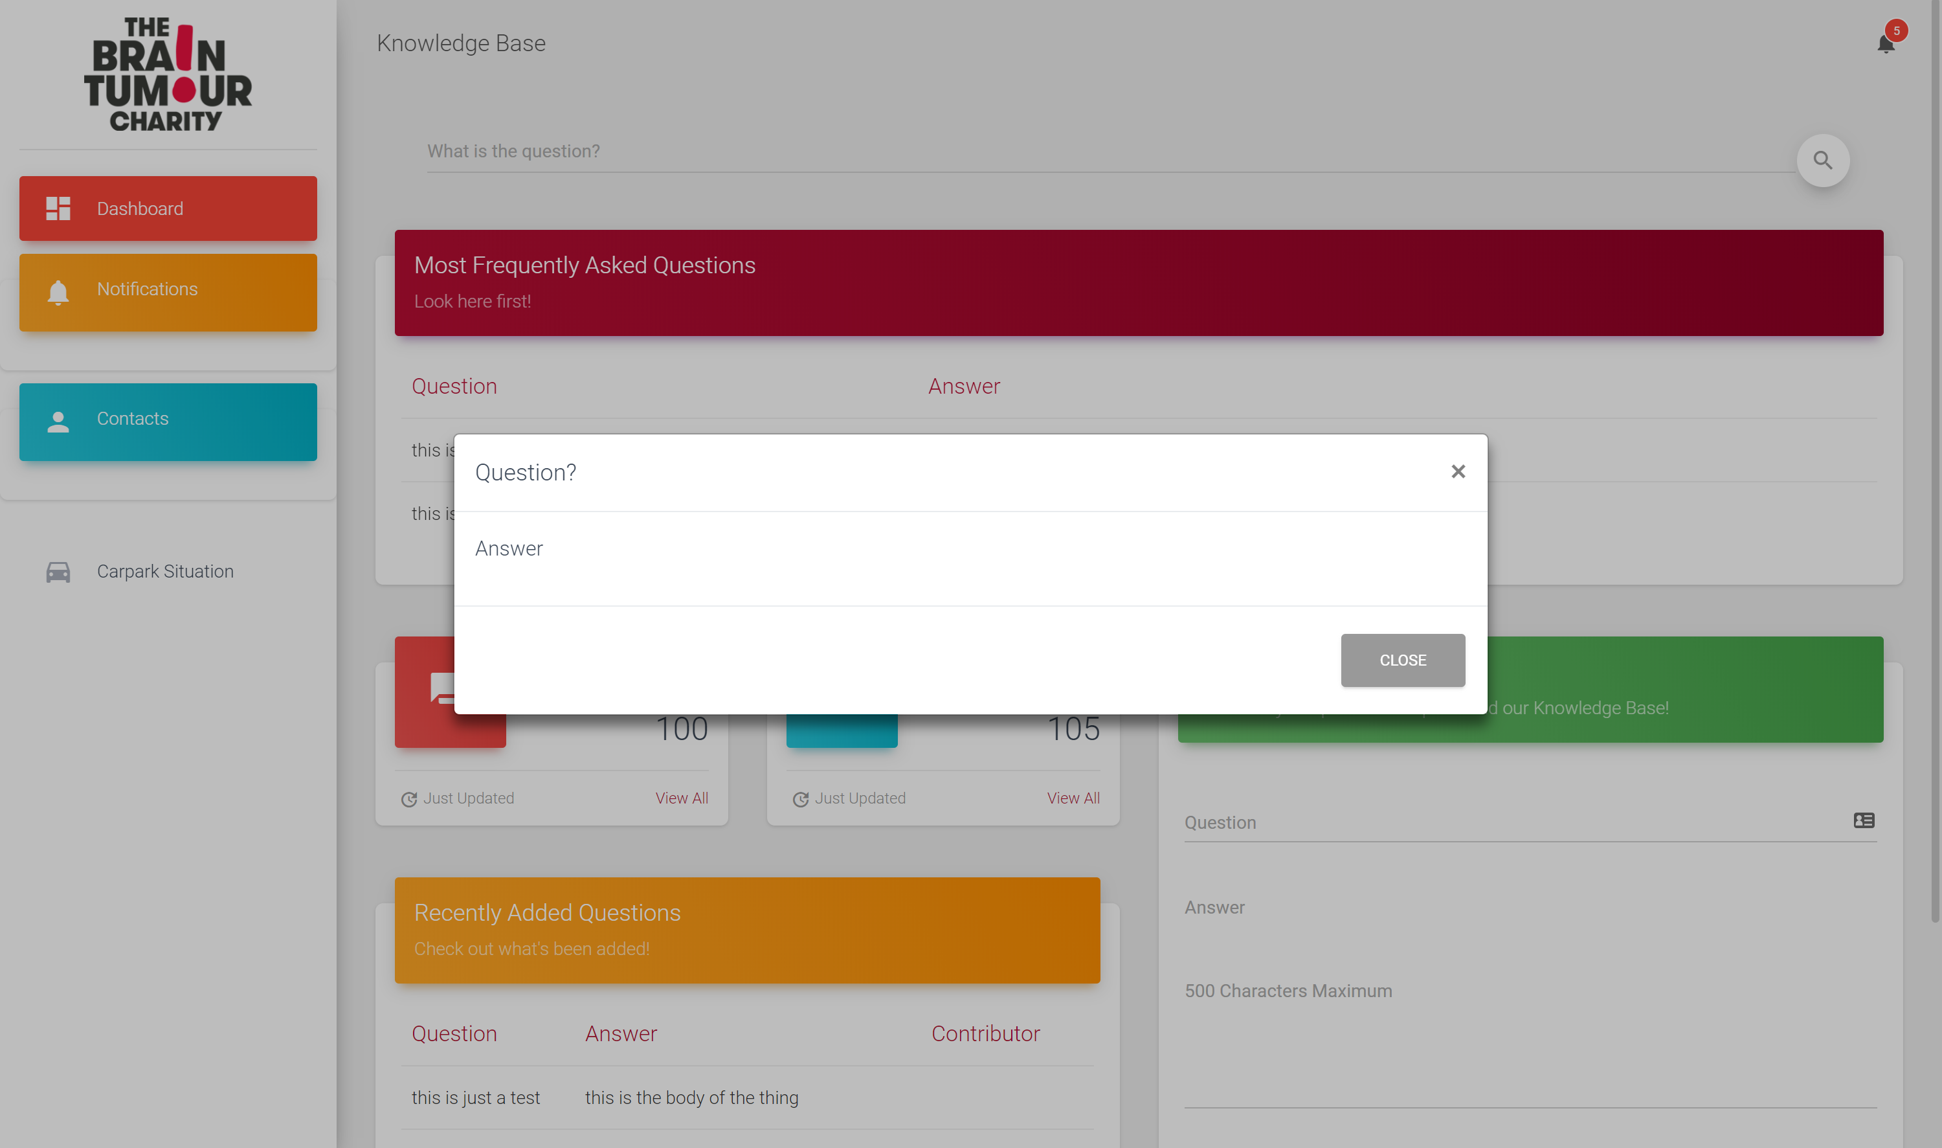
Notes:
What happens when you submit a question –the answer

Slide 13
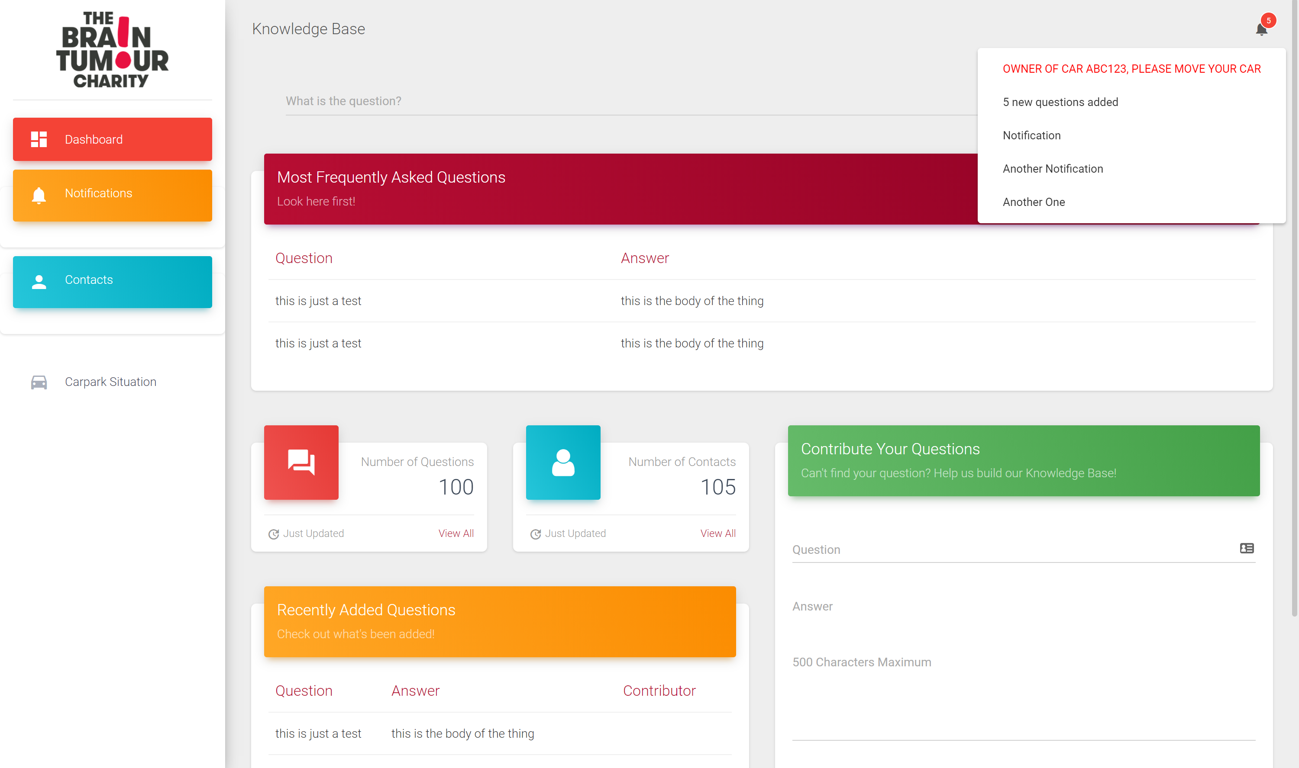
Notes:
Notification for moving cars

Slide 14
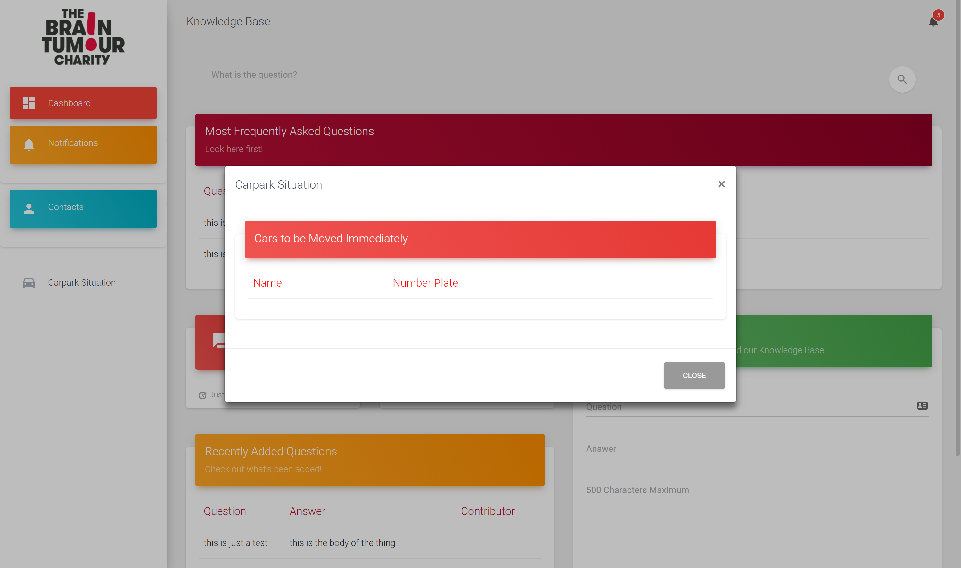
Notes:
Carpark situation

